Slide 1

SQL Project
Ironhack
2023

Slide 2

I. Data Cleaning
Tabla | Nulos | Duplicated | Drop | Changes
actor | No | SUSAN DAVIS | last_update | Capitalize first & last name
category | No | No | last_update
film | original language | No | last_update | Upper title & description
inventory | False | No | last_update
language | No | No | last_update
old_HDD | No | No | release_year
rental | No | No | last_update

Slide 3
II. Data Exploration
2.1. special_features:
New table “special_features”
Asociation with “films”: many to many
New table “film_has_special_features”
2.2. category
category_id to film from old_HDD Nan to new "category": "Unknown"
2.3. films & actor
Add film_id to old_HDD
Add actor_id to old_HDD
Delete everything else, so we’ve got "film_has_actor“
2.4. Inventory & rental
One film at a time? No way…
Reconvert Inventory to rental_detail with “film_id” and “rental_id”
2.5 "language"
Add 'Unknown' to language for original_language_id in film

Slide 4
III. Database Filling
3.1. New records for film
Thanks to Faker library
3.2. Records for new table “customer
Thanks to Faker library too
3.3. Fill new “price” column in “rental”
With a simple function

Slide 5
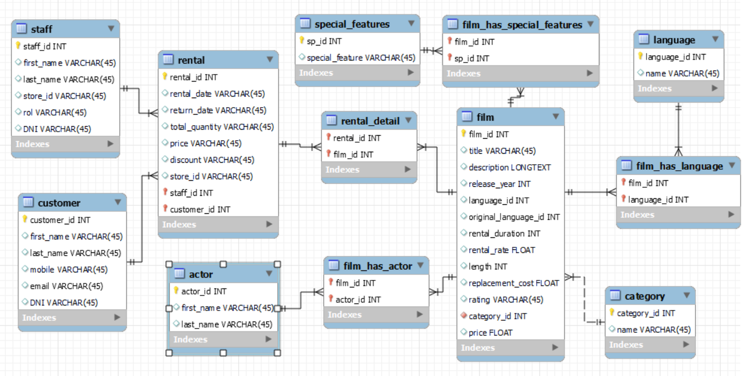
VI. ERD
Inventory
Old_HDD

Slide 6
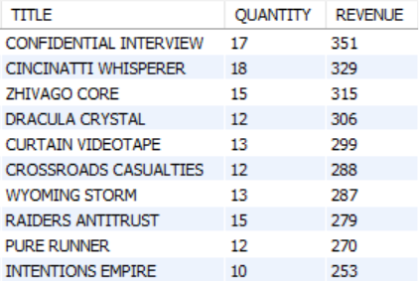
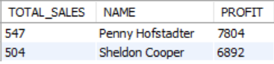
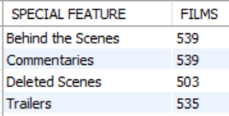
V. Querys
Top 10 Films
Best Seller
Special Features

Slide 7
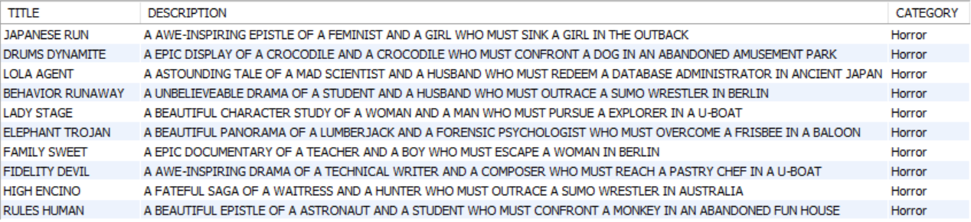
V. Querys
Top 10 Horror Films

Slide 8
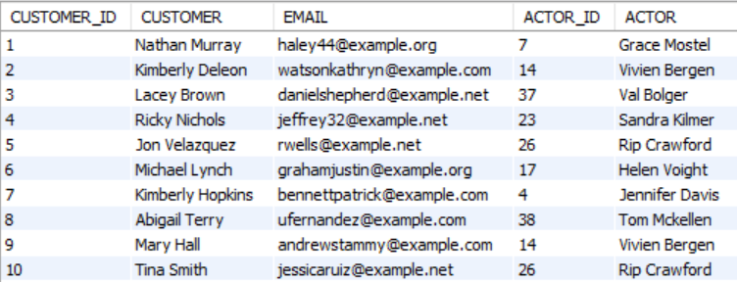
V. Querys
Favorite actor per customer
Notes:
ROW_NUMBER() en SQL asigna un número secuencial a cada fila de un conjunto de datos
PARTITION BY c.customer_id: el conteo y el orden se aplicarán para cada cliente individualmente. Cada cliente tendrá su propio conjunto de numeración de filas.

Slide 9
Some ideas that did not make it...
DVD readers table
Because no one has one now a days…
Actors' awards
For promotions in the run-up to the awards ceremony
Customer category
To reward those who behave well
Notes:
ROW_NUMBER() en SQL asigna un número secuencial a cada fila de un conjunto de datos
PARTITION BY c.customer_id: el conteo y el orden se aplicarán para cada cliente individualmente. Cada cliente tendrá su propio conjunto de numeración de filas.

